Slide 1
CINEMA SEAT
BOOKING SYSTEM
Java-Based Application

Slide 2
Abstract
02
1
Purpose
2
Core Functions
3
Benefits & Future
A computerized application designed to make selecting and reserving cinema seats easier and more convenient, replacing queue-based or manual availability checking with an organized digital solution.
Users can view movies and show timings, select preferred seats and reserve tickets. The administrator can manage movie information, update schedules, monitor seat availability and maintain booking details.
The system reduces manual work, saves time and keeps booking information organized. Future enhancements include online payment, ticket cancellation, booking history, digital ticket generation and notifications.
22/09/2026
2

Slide 3
Simple Roadmap
03
1
1. Choose Technology
4
4. View Movies
Use: Java
Display movie names and available show timings.
2
2. Main Menu
View Movies • Book Ticket • View Booking Details • Admin – Add Movie • Exit
5
5. Book Ticket
Select movie → show timing → seat → customer name.
3
3. Core Data Structures
6
6. Confirm Booking
movies[] • showTimings[][] • seats[][] • bookings ArrayList
Check availability → update seat → store booking details.
22/09/2026
3

Slide 4
System Components
04
1
Movie Details
2
Show Timings
3
Seat Status
Movie names are stored and displayed to users.
Each movie has three available show timings.
10 seats are maintained for each movie.
4
Booking Details
5
Admin Function
6
Validation
Customer, movie, show and seat details are stored.
Admin can add a new movie and display it as confirmation.
Invalid movie, timing or seat selections are handled.
Main Java structures used in the project
String[] • String[][] • boolean[][] • ArrayList<String> • Scanner
22/09/2026
4

Slide 5
Develop Step-by-Step
05
1
Step 1: View Movies
4
Step 4: Check Seats
Display available movies and their show timings.
Display each seat as AVAILABLE or BOOKED.
2
Step 2: Select Movie
5
Step 5: Book Seat
User enters the movie number; invalid selections are rejected.
Accept seat number and prevent booking if the seat is already booked.
3
Step 3: Select Show
6
Step 6: Store Booking
Display the three show timings and accept the selected timing.
Take customer name, update seat status and add booking details.
22/09/2026
5

Slide 6
Booking Flow & Testing
06
Booking Flow
Testing Checklist
• Select movie
• Select show timing
• Check seat availability
• Enter seat number
• Enter customer name
• Display booking successful
• View movies and timings
• Test valid and invalid movie selection
• Test valid and invalid timing
• Check AVAILABLE / BOOKED seats
• Try booking an already booked seat
• View booking details and add a movie
22/09/2026
6

Slide 7
Understanding Problem Statement
07
The Need
Traditional ticket booking may require customers to wait in queues or depend on manual records to check seat availability.
The Solution
The Cinema Seat Booking System provides a digital solution to organize movie details, show timings, seats and booking information. It helps users reserve preferred seats and helps administrators manage schedules, availability and customer bookings.
Result
It reduces manual work, saves time, improves accuracy and helps avoid duplicate bookings.
22/09/2026
7

Slide 8
CO 1 Topics
08
1
Variables & Data Types
4
ArrayList
Store movie names, show timings, seat status, customer names and booking choices.
Store multiple booking details dynamically.
2
Scanner
5
Operators
Take menu choices, movie numbers, timings, seat numbers and customer names as input.
Use comparison and logical conditions to validate movie, timing and seat selections.
3
Arrays
6
Methods
Use 1D and 2D arrays to organize movies, show timings and seat status.
Separate functions such as viewMovies(), bookTicket(), viewBookings() and addMovie().
22/09/2026
8

Slide 9
CO 2 Topics
09
1
if-else
4
do-while Loop
Check whether a selected seat is already booked and decide the booking result.
Keep displaying the main menu until the user chooses Exit.
2
if Conditions
5
switch Statement
Validate movie numbers, show timings and seat numbers.
Handle the five main menu choices.
3
for Loop
6
Input Validation
Display movies, show timings and seat availability.
Display suitable messages for invalid selections and already booked seats.
22/09/2026
9

Slide 10
CO 3 Topics
10
1
1D Array
4
Searching / Selection
Store the list of movie names.
Find the selected movie and show timing using the user's choice.
2
2D Arrays
5
ArrayList Traversal
Store show timings and seat status for multiple movies.
Display all stored booking details.
3
Array Traversal
6
Status Update
Use loops to access movies, timings and seats.
Change a seat from AVAILABLE to BOOKED after successful reservation.
22/09/2026
10

Slide 11
CO 4 Topics
1 Classes & Objects
Model Movie, Show, Seat and Booking as objects with their own data and behavior.
2 Encapsulation
Keep fields private and access or update them through methods such as bookSeat() and getBookingDetails().
3 Relationships
A Booking connects a customer with a selected movie, show timing and seat.
4 Exception Handling
Use try-catch to handle invalid input and unexpected errors without abruptly stopping the program.
5 Robust Booking
Validate seat and movie selections before confirming a booking to reduce invalid records.
6 Project Application
These concepts can structure the current system into maintainable classes instead of one large program.
11

Slide 12
CO 5 Topics
1 String API
Use String methods to format customer names and movie titles, such as trim(), toUpperCase() and equalsIgnoreCase().
2 StringBuilder
Build readable booking summaries by appending customer, movie, show and seat details.
3 Searching
Search movie titles or booking records using text comparison and contains().
4 Comparison & Sorting
Compare movie names or sort displayed titles and booking summaries when needed.
5 File Input/Output
Save booking details to a file and read them later to keep records between program runs.
6 Project Application
These features can improve search, display and persistence beyond the current in-memory ArrayList.
12

Slide 13
CO 6 Topics
1 Collections Framework
Use ArrayList<Booking> to store a flexible number of bookings as objects.
2 Collection Operations
Add, remove and iterate through bookings using collection methods and loops.
3 Functional Interfaces
Use a Predicate or Consumer to define a small reusable operation on booking data.
4 Lambda Expressions
Use concise lambda expressions for filtering or displaying matching bookings.
5 Stream Pipelines
Filter bookings by movie or customer and collect or display the matching results.
6 Project Application
These are suitable extensions for searching and managing booking records; they are not required by the current basic implementation.

Slide 14
Future Enhancements & Conclusion
Future Enhancements
Conclusion
• Online payment
• Ticket cancellation
• Booking history
• Digital ticket generation
• Notifications
The Cinema Seat Booking System provides a simple and efficient way for customers and cinema staff to manage movie details, show timings, seat availability and ticket reservations. It makes the process more organized, accurate and convenient.
Java concepts are applied to solve a practical ticket-booking problem.

Slide 15
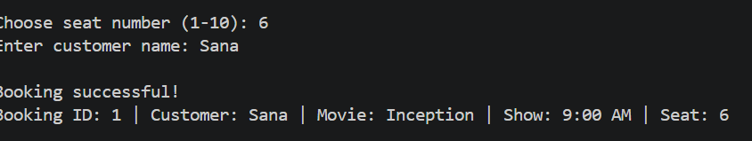
SCREEN SHOTS
Output

Slide 16
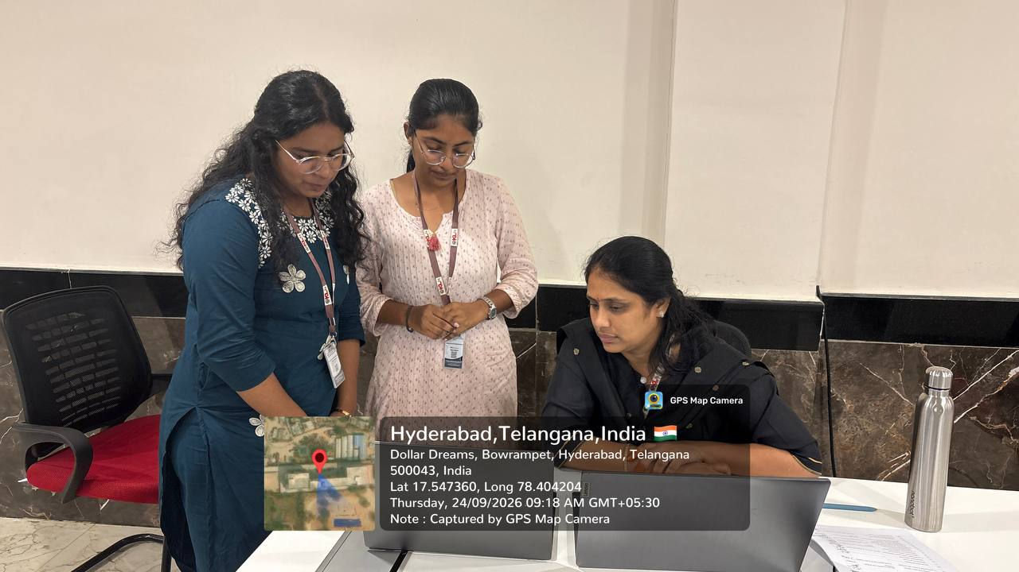
GEO TAG PHOTO AND GIT HUB LINK
https://github.com/Sanaa2204/KLH-Bachupally-2026-2027-Batch-27-CinemaSeatBookingSystem
https://github.com/ganjikuntameghana-max/KLH-Bachupally-2026-2027-BATCH-27-Cinema-Seat-Booking

Slide 17
THANK YOU
Sana - 2620090007
Meghana - 2620040142
Cinema Seat Booking System

